Slide 1
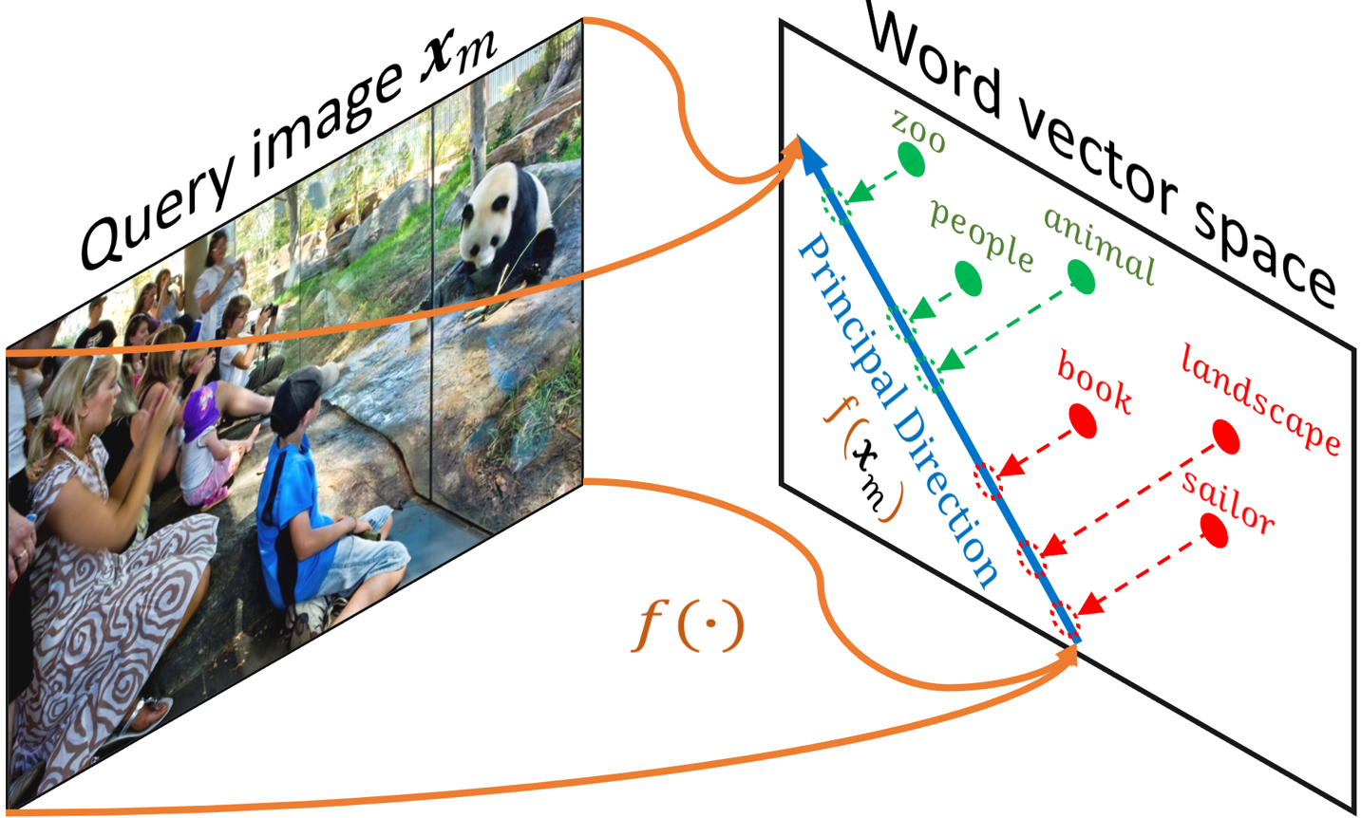
Fast zero shot learning
Nguyễn Hữu Mạnh

Slide 2
01
02
03
04
05
Introduction
Approach
Image tagging with fast-zero shot learning
Approach for problem of image tagging
Data & Pre-processing
Pre-processing the data
Model & architecture
Detail the architecture of model, algorithm and loss function
Result & evaluate
Some result and evaluation of model

Slide 3
Part 1. introduction
Image tagging with fast-zero shot learning

Slide 4

Image tagging and Application
Build auto-tagging system
Search engine for google ..

Slide 5
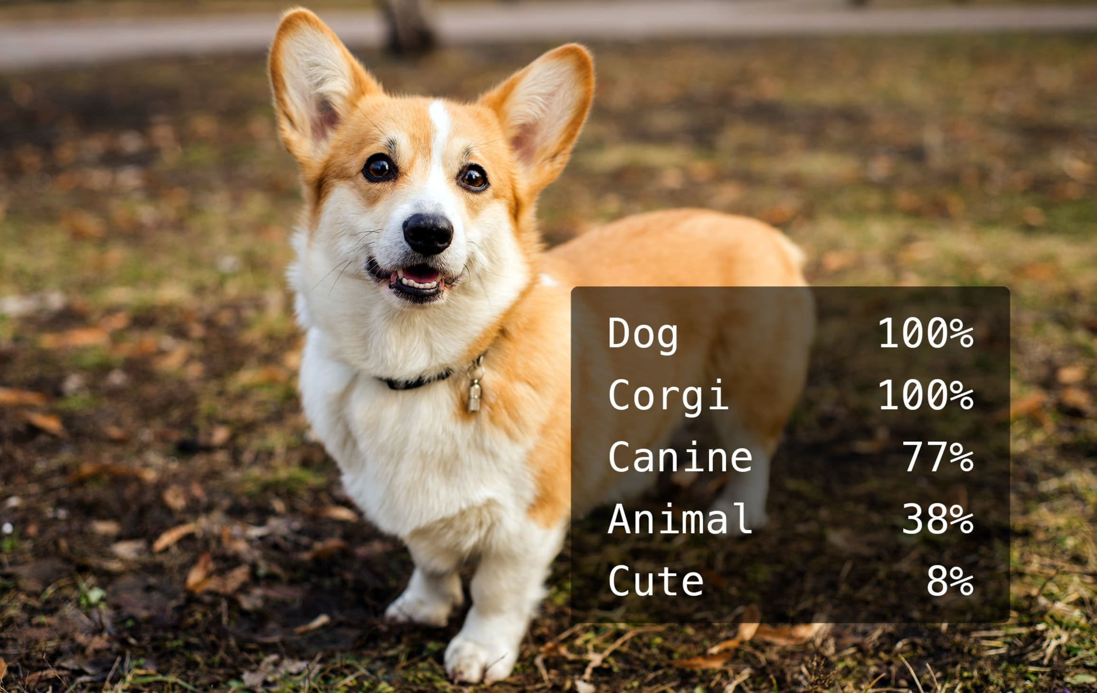
Image tagging and problems
All the tag are given in training phase
How to tag image which it’s tag is not given in training phase
Zero shot learning

Slide 6
Part 2. Approach
A new approach for solving image tagging problem

Slide 7
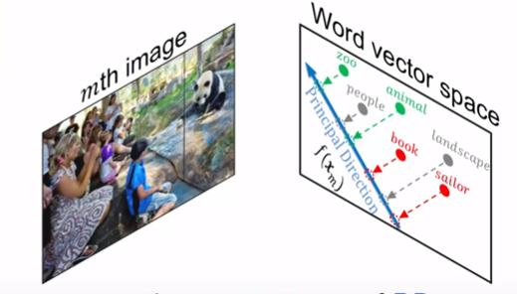
Zero shot learning
Find the Principal Direction between Image and Word vector space
Project unseen tags to this Principal Direction
Get the best 5 tags upon ranking

Slide 8
Part 3. Data & pre-processing
Overview of using dataset and pre-processing

Slide 9
Dataset
Dataset: IAPR-TC12 dataset with 20k images split into :
+ train set: 15k images
+ validation set: 2,6k images
+ test set: 2,2k images
- Label of 291 seen tags
- 81 unseen tags from NUSWIDE dataset

Slide 10
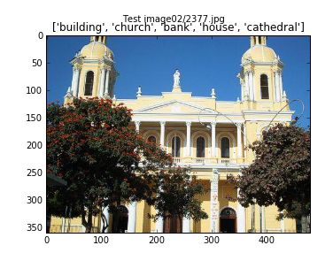
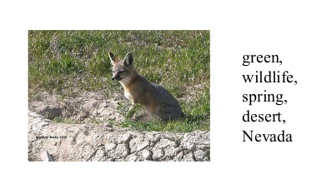
Dataset example

Slide 11
Data pre-processing
Image encoding
Using VGG19 to encode image to feature vector
word embedding
Glove to embed word label to word feature vector

Slide 12
Part 4. model & architecture
Detail the architecture of model, algorithm and loss function

Slide 13

Principal Direction using Deep Learning
f (.)
Dense Linear
2048 D
300 D
Dot
Y_predict
Dense Relu
Dropout 30%
300 x 291 D
8096 D
Word Embedding
Dense Relu
4096 D
Tags
Pre-trained CNN

Slide 14
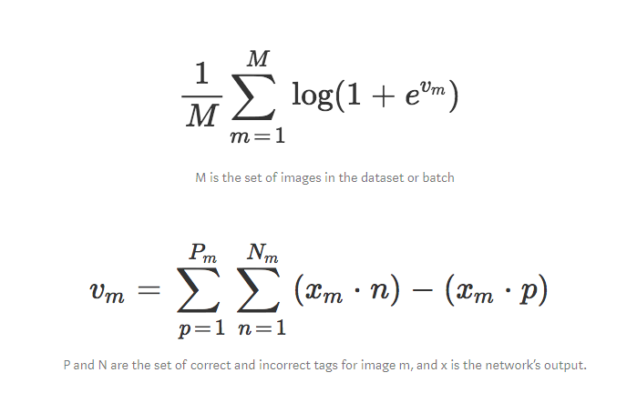
Loss function

Slide 15
Part 5. Result & evaluate accuracy
Some result and evaluation of model

Slide 16
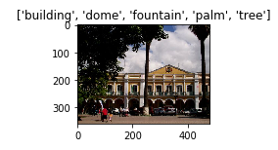
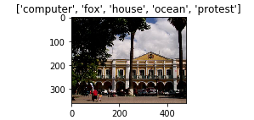
Result & evaluating accuracy
result
Seen tags
Unseen tags

Slide 17
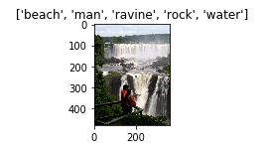
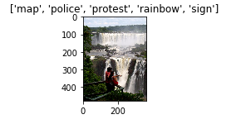
Result & evaluating accuracy
result
Seen tags
Unseen tags

Slide 18
Result & evaluating accuracy
evaluate accuracy
Evaluate in both seen and unseen tags
Accuracy with F1 score:
~ 46% with seen tags
~ 20% with unseen tags

Slide 19
THANKS for listening
Does anyone have any questions?

